Slide 1


Healthcare Scenario – Healthy Living and Wellness Clustering
Abhishek Sharma
MGT 665 – Solving Business Problems with Machine Learning
Northwood University
06/22/2025

Slide 2
Project Overview and Introduction
Abstract
Introduction
Unsupervised learning applied to health indicators.
Proactive health management via data segmentation.
PCA retained 95% variance, reduced complexity.
Clustering reveals behavioral wellness patterns.
K-Means silhouette improved from 0.13 to 0.73.
PCA addresses high dimensionality, multicollinearity.
Hierarchical clustering improved to 0.38.
Goal: Analyze cluster structure before and after PCA.

Slide 3
Key Literature Supporting Our Approach
Lu & Uddin (2024)
Trezza et al. (2024)
Alanazi (2022)
PCA enhances disease cluster prediction and improves model interpretability in medical diagnostics.
AI provides personalized wellness segmentation, driving tailored health interventions for individuals.
Machine Learning transforms healthcare data insights, revealing hidden patterns in patient data.

Slide 4




Methodology: Data Processing and Clustering
Dataset Overview
200 patients, 5 key wellness indicators were collected and analyzed.
Exploratory Data Analysis
EDA showed right-skewed BMI and normal-like sleep patterns.
Data Preprocessing
StandardScaler was applied; PCA retained 95% of variance.
Clustering Algorithms
K-Means and Agglomerative Clustering were evaluated for performance.

Slide 5




Evaluation Metrics: Assessing Cluster Quality
Silhouette Score
Measures cluster cohesion and separation. A higher score indicates better-defined clusters.
WCSS (Within-Cluster Sum of Squares)
Indicates cluster compactness. Lower WCSS values suggest tighter clusters.
Comparative Evaluation
Clustering performance was rigorously assessed before and after PCA application.

Slide 6
Key Results :Quantitative Comparison Clustering Metrics
Metric
Before PCA
After PCA
Silhouette Score (K-Means)
0.13
0.73
WCSS (K-Means)
286
324
Silhouette Score (Hierarchical Clusters). 0.07 0.38
The table clearly illustrates the significant boost in cluster quality for K-Means after applying PCA, as indicated by the silhouette score. The slight increase in WCSS suggests broader clusters but with better separation.

Slide 7
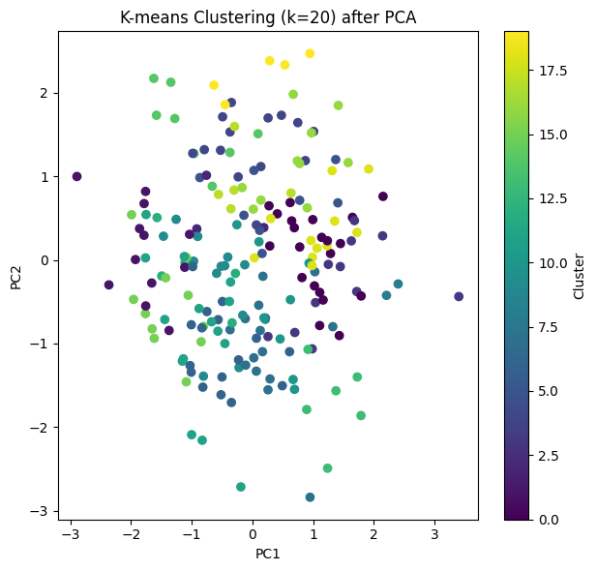
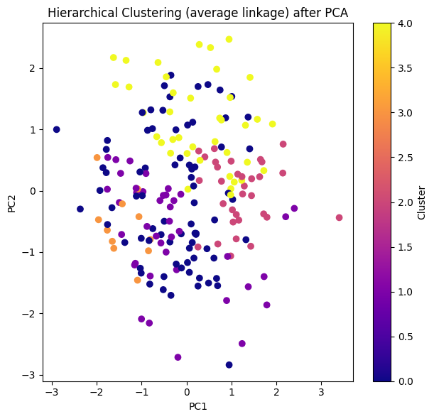
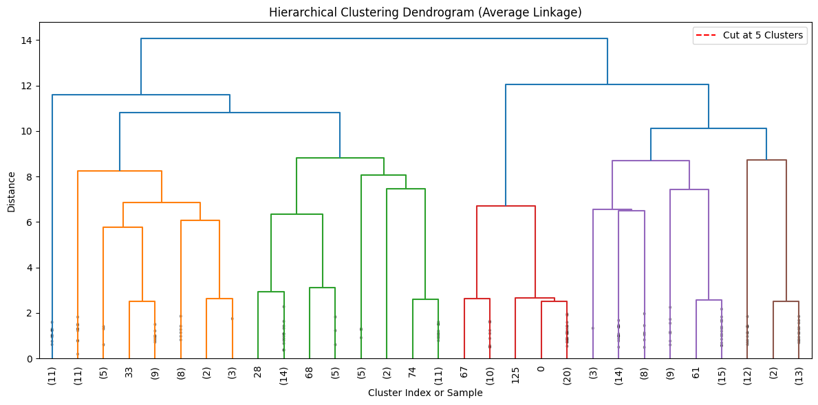
Visual Insights: Cluster Separation Post-PCA
K-Means PCA Plot
Hierarchical PCA Plot & Dendrogram
Shows strong, distinct separation of patient groups,
indicating effective clustering.
Reveals moderate separation, with the dendrogram supporting a 5-cluster structure.
These visualizations underscore PCA's effectiveness in enhancing cluster definition, providing clear insights into patient segmentation.

Slide 8
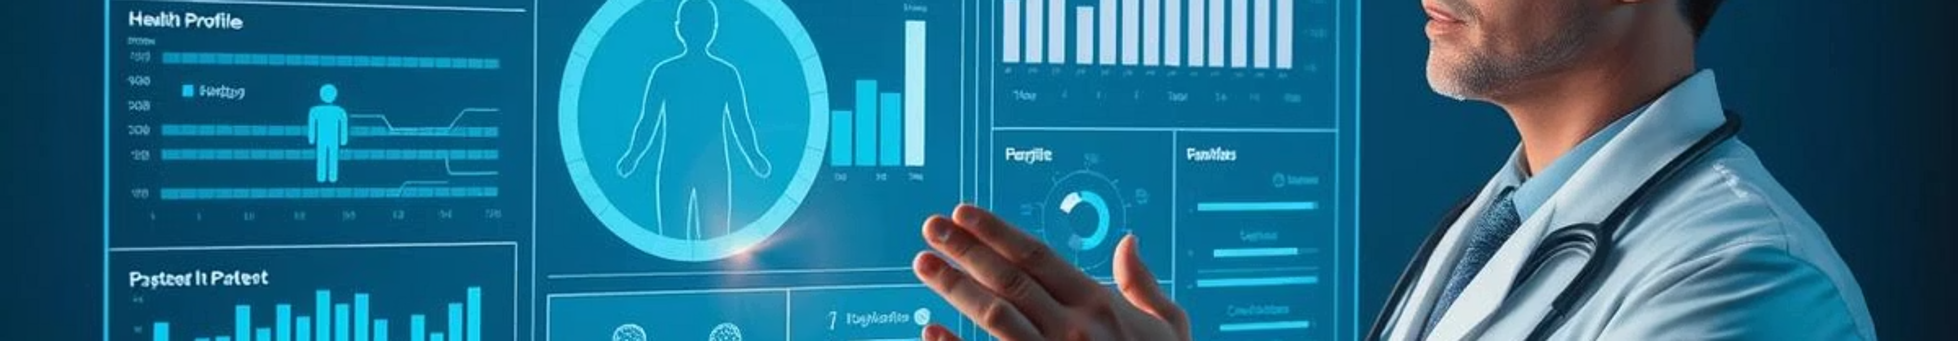
Discussion: PCA's Role in Healthcare Segmentation
PCA's Impact
Algorithm Responsiveness
Principal Component Analysis significantly improved clustering performance and data clarity.
K-Means demonstrated greater responsiveness to PCA-driven data transformation.
Healthcare Validation
Personalized Interventions
The study validates PCA's critical role in robust healthcare data segmentation.
These findings support developing personalized interventions for patient wellness management.

Slide 9

Conclusion and Future Directions
Effective Segmentation
PCA combined with clustering offers effective patient segmentation capabilities.
K-Means Superiority
K-Means performed optimally after dimensionality reduction via PCA.
ML in Healthcare
This work encourages greater adoption of ML in healthcare analytics.
Future Research
Future work involves applying this on real-world datasets and exploring other algorithms like DBSCAN.

Slide 10
References
Jolliffe, I. T., & Cadima, J. (2016). Principal component analysis: A review and recent developments. Philosophical Transactions of the Royal Society A: Mathematical, Physical and Engineering Sciences, 374(2065), 20150202. https://doi.org/10.1098/rsta.2015.0202
Lu, H., & Uddin, S. (2024). Unsupervised machine learning for disease prediction: A comparative performance analysis using multiple datasets. Health and Technology, 14(2), 305–320. https://link.springer.com/article/10.1007/s12553-023-00805-8
Trezza, A., Visibelli, A., Roncaglia, B., Spiga, O., & Santucci, A. (2024). Unsupervised learning in precision medicine: Unlocking personalized healthcare through AI. Applied Sciences, 14(20), 9305. https://doi.org/10.3390/app14209305

Slide 11
Thank you!

